Slide 1
Council of the European Union
French Presidency, January-June 2022.
« Relance, puissance, appartenance »
(“Recovery, power, belonging”)

Slide 2
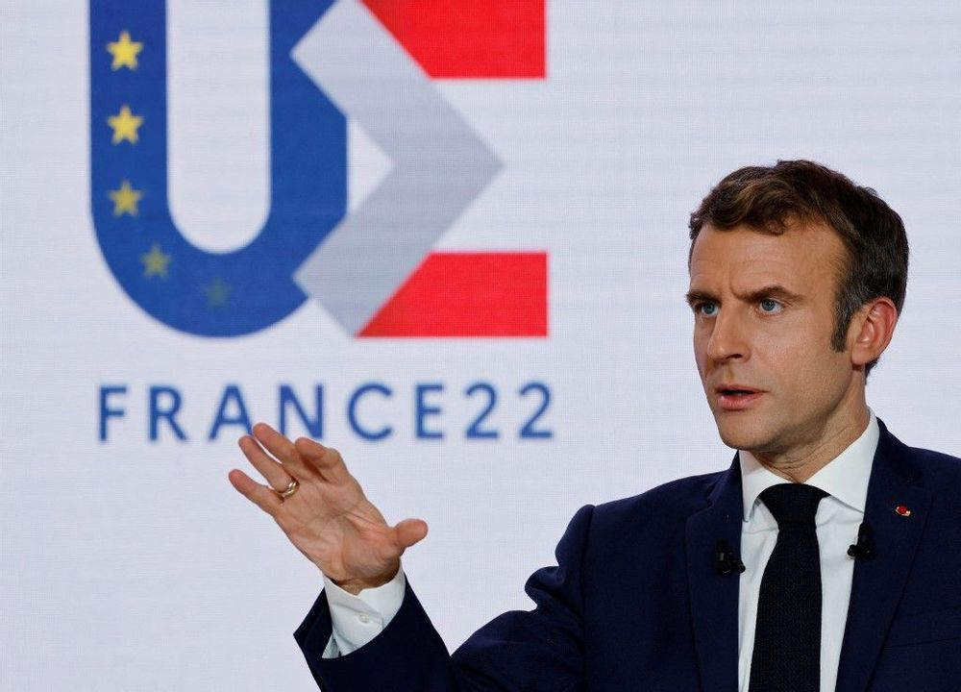
President Emmanuel Macron’s press conference, 09 December 2021
French Presidency of the Council of the European Union – 11/01/2022

Slide 3
The French Presidency’s programme focuses on three priorities:
« Relance, Puissance, Appartenance »
Recovery we are still in a moment of crisis and we must build an economic response at the European level.
Strength: as the condition of the European model which must be preserved and promoted throughout the world.
Belonging: no political project can last without a collective feeling of participating in an important adventure. These are shared values, a culture we have in common, a history that connects us as well as plans for the future.
French Presidency of the Council of the European Union – 11/01/2022

Slide 4
French Presidency priorities
Social inclusion and fundamental rights …
Holding a ministerial conference on accessibility and access to rights for persons with disabilities
Proposing a Social Protection thematic review on access to rights for vulnerable groups
…at every stage of life
Holding a ministerial conference on the implementation of the European Child Guarantee
Holding a ministerial conference on the prevention of the loss of autonomy
Following the European objective of fighting homelessness
Women’s right and gender equality
Holding a ministerial conference on women's economic empowerment
Advancing negotiations on the proposed directive on binding pay transparency measures
Unlocking discussions on the proposed directive on gender balance in company boards
Proposing Council Conclusion on violence against women, in the scope of the Beijing Platform for Action monitoring, theme D
French Presidency of the Council of the European Union – 11/01/2022

Slide 5
French Presidency Events - DGCS
27 January Ministerial conference “Preventing the loss of autonomy: for a better cooperation on the issue of falls”
28 January High Level Group on Gender mainstreaming
31 January Ministerial conference “Women's economic empowerment: key to gender equality”
14 February informal EPSCO Council
14 March EPSCO Council
04 March Ministerial conference “Building Europe’s future : implementing the European Child Guarantee”
09 March Ministerial conference “Improving accessibility and access to rights, implementing the European Strategy 2021-2030”
16-17 March SPC, thematic review on access to rights for vulnerable groups and the problem of non-take-up, in the context of the digital transition
02-03 June MISSOC, Mutual information system on social protection
16 June EPSCO Council
French Presidency of the Council of the European Union – 11/01/2022

Slide 6
Ministerial conference
“Women economic empowerement : key to gender equality”
31 January 2022
Objectives :
Bring together the ministers responsible for gender equality, the European Commissioner for Equality and the Director of the European Institute for Gender Equality (EIGE) ;
Focusing on the implementation of the priorities of the European Strategy, the fight against stereotypes, professional equality, reconciliation of life time and investment in digital education and female entrepreneurship.
Provisional programme :
Presentation of the Trio Presidency Declaration on Gender Equality 2022-2023
Working meeting of the ministers in charge of equality on women's economic empowerment
First ministerial roundtable
What measures are being taken in your state to enable women to effectively access the labour market?
Second ministerial roundtable
How does your Member State ensure professional equality for women and men throughout their careers?
French Presidency of the Council of the European Union – 11/01/2022

Slide 7
Lesgislative activities
The French Presidency will work to bring forward :
The proposed directive on binding pay transparency measures ;
The proposed directive on gender balance in company boards.
French Presidency of the Council of the European Union – 11/01/2022

Slide 8
Non-lesgislative activities
The French Presidency will propose :
Council Conclusions on violence against women, in the scope of the Beijing Platform for Action monitoring, theme D
→ The Council Conclusions will be proposed for adoption at the EPSCO Council in June, 2022.
French Presidency of the Council of the European Union – 11/01/2022

Slide 9
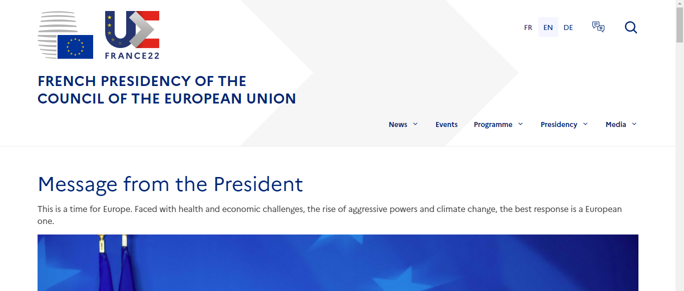
More information on the French Presidency website :
europe2022.fr
French Presidency of the Council of the European Union – 11/01/2022

